Slide 1
IBM Addresses the Elements of the Nexus of Forces
IBM has offerings in each Nexus force: cloud, social, mobile and
information. While integration of these forces is shown in its Smarter Planet
offerings, We sees opportunities for greater integration across IBM solutions.
Key Findings
■
IBM's Smarter Planet strategy and its growth initiatives align to the Nexus of Forces targeting
cloud/smarter systems, business analytics and optimization (including big data), social
business, mobile and expansions in geographic growth markets.
■
IBM's cross-business, segment solutions strategy sees it shift from product and brand
centricity toward business solutions and services. These solutions are linked to growth
initiatives and are centered around its SmartCloud, Smarter Analytics, Smarter Commerce,
Smarter Cities, mobility and Social Business strategies.
■
IBM's offerings, vision and the road map for business analytics and information management
are strong. IBM's building on its Watson Solutions to power these offerings, with targeted
industry solutions.
■
While not a mobile device provider, IBM provides enterprise mobile solutions, including device
management, telecom expense management, master data management, business analytics and
mobile application development. Access is gained to the offerings under IBM's Social Business
strategy.
■
IBM has the potential, the market scale and the cash to invest in and to drive the cloud, mobile
and social forces forward in enterprises. However, integration is a key component of the Nexus
of Forces, and IBM's progress is at various stages within these forces.

Slide 2
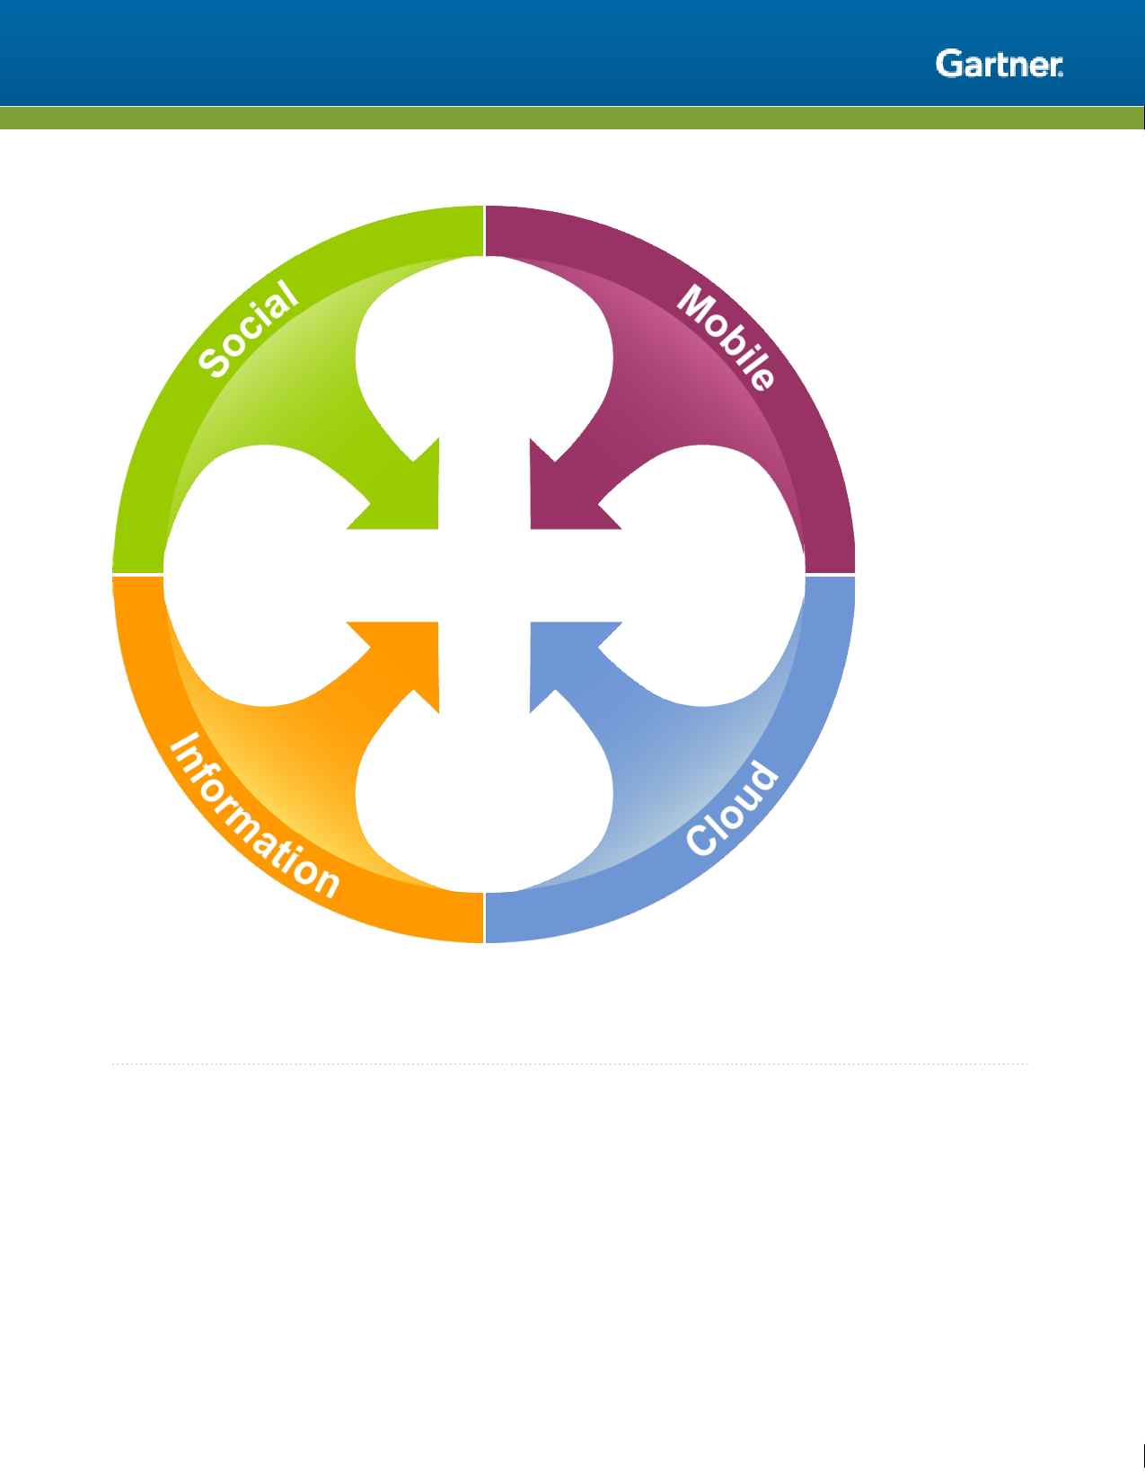
Figure 1. The Nexus of Forces
Source: Gartner
IBM Opens Paths Toward the Nexus of Forces
The spectrum of a vendor's involvement in the Nexus is somewhere within identifying, combining,
riding and driving the Nexus phenomenon. Consumerization of IT forms the backdrop for the Nexus,
and IBM has a strategy for all the Nexus forces. But outside Smarter Planet, while IBM can show
many examples across the forces where it has integrated and linked forces, like cloud to analytics
or social to mobile, it still has some work to do to show a complete story for how each Nexus force
combines with the others to create patterns that transform projects, organizations, markets and
industries. That said, IBM is working toward this aim. It creates and delivers its strategy through the
interconnections of its hardware, software and services groups; it just needs to work from a unified
vision that ties these efforts together.
Page 3 of 10

Slide 3

This research note is restricted to the personal use of michel.martel@riotinto.com
One role that IBM plays is as an enabler in the Nexus of Forces — its hardware, software and
services are all parts of Nexus solutions. IBM offers servers and integrated solutions (PureFlex
System, PureApplication System and Watson expert integrated solutions) that provide enabling
technology for cloud computing, pattern-based application deployment and analytics — through
Cognos and SPSS. IBM Connections provides collaboration and enterprise social networking
solutions.
IBM can deliver an end-to-end service that incorporates each of the Nexus forces, or else it can
create mass-customized industry solutions like Smarter Cities. IBM's Smarter Planet initiative
1
encapsulates the idea behind the Nexus of Forces and the notion of the Internet of everything,
which is a companion concept to the Nexus of Forces. IBM has the capability to transform
computing in the high growth areas of optimized workloads and cloud, mobile enterprise, big data
analytics, and security intelligence. Here we take a more in-depth look at IBM's delivery of each of
the Nexus forces.
Social
The IBM Social Business Strategy and supporting solutions are positive moves to embrace the
social force (see Note 2 and "IBM's Social Business Strategy in Its Second Year"). IBM isn't limiting
its solutions to IBM proprietary software and has moved beyond just Lotus in its social ambitions.
This is leading to a less technology-focused social message and is opening the door to more
effective targeting of business buyers.
IBM uses social technologies to enable clients to share knowledge, analyze interactions and deliver
actionable insights. IBM Social Business integrates capabilities across mobility, big data, consulting
on analytics content and process management, with security and compliance capabilities. IBM
SmartCloud for Social Business supports a full range of devices with one-click access to social
networking, virtual meetings, email, calendaring and instant messaging.
While IBM has improved its social business strategy and execution, it needs to overcome some
challenges. IBM is moving from selling the Lotus brand to selling the business impacts and
outcomes of Social Business, as well as expanding its focus on enterprise buyers to support more
consumer-based technologies. The portfolio underpinning the IBM Social Business strategy is
currently accessible via consumer devices (such as smartphones and tablets) running Android and
Apple iOS. IBM's internal support, including investment, for Social Business is strong, and its
2
reputation as a viable option among existing and potential buyers is helping IBM take advantage of
the opportunities in social computing.
Mobile
IBM doesn't intend to be a player in the mobile device business, and it doesn't have plans to re-
enter the direct consumer market. However, IBM's mobile strategy isn't based on a specific device.
Rather, it's based on helping enterprises build and connect mobile applications, manage and
secure mobile devices and mobile applications, and extend and transform business models using
mobile technologies. IBM's strategy supports corporate-liable devices and also helps enterprises

Slide 4
This research note is restricted to the personal use of michel.martel@riotinto.com
capitalize on the bring-your-own-device trend. Rather than re-enter the consumer market, IBM
supports the widest ranges of mobile operating environments including iOS, Android and Windows.
The strategy includes little insight into the impact of mobile on social adoption and interaction
styles. There is little to illustrate how topics such as mobile payments, Near Field Communications
or social crowdsourced development for mobile apps can change things, such as lending and
buying experiences for customers. However, under the "social portal" elements of Social Business,
the IBM Customer Experience Suite ties the mobile apps platform to back-end information systems.
These types of linkages make the Nexus an opportunity that grows as the forces combine.
IBM views the mobile force as a big opportunity, and it's expected that it will continue to refine its
mobile strategy. IBM acquired the mobile development platform Worklight. This
acquisition points to IBM's focus on a broad mobile strategy, supported by multichannel
capabilities (including Web, mobile Web, hybrid and native) and powered by the combination of
WebSphere Portal and Worklight working together. Gartner expects that IBM will integrate this
focus into enterprise mobility consulting and system integration. One of IBM's challenges will be to
simplify its complex strategy and integrate offerings between brands that contribute to its mobile
offerings. Integration challenges are prevalent in the industry, with vendors having to integrate old
and new technologies. IBM's mobility capabilities also underpin its Social Business strategy and are
delivered via Traveler, Connections Mobile, Mobile SameTime IM and Meetings, and the IBM
SmartCloud mobile meeting and mail support.
IBM recently launched Mobile Device Management (MDM) offerings, the latest being IBM Endpoint
Manager for Mobile Devices. It allows for the management of mobile devices running iOS, Android,
Symbian and Windows Phone OSs. It takes advantage of the acquisition of BigFix
3
which IBM added to its Tivoli business unit. IBM Endpoint Manager for Mobile Devices
complements its managed desktop offerings, and IBM is one of only a few vendors that can support
desktops and mobile devices.
IBM has products that could integrate well into an MDM platform; for example, it offers telecom
expense management capabilities through its Emptoris acquisition, and mobile application
development via Worklight. IBM integrated Lotus Notes Traveler with MDM, and it has indicated
that it plans to offer integration between Worklight and Endpoint.. However, to
4
date, integrated offerings are limited. Within the MDM market IBM faces relatively few competitors
that offer unified management of smartphones and laptops or desktop systems, a competitive
advantage for IBM.
IBM markets its IBM Mobile Enterprise strategy as a competitive differentiator. This strategy goes
beyond MDM to include a mobile application development platform, telecom expense management,
business analytics, social collaboration and managed service capabilities.
Cloud
As with mobile, IBM has additional work to do in tying cloud computing together with the other
forces to create a true Nexus of Forces story. This is due in part to IBM's delay in delivering to
market a true public cloud offering. However, with the introduction of SmartCloud , IBM has

Slide 5
This research note is restricted to the personal use of michel.martel@riotinto.com
shown increasing interest in public cloud offerings. SmartCloud is capable of more than just private
cloud enablements, which are not easily leveraged through the Nexus.
IBM is gaining traction with its cloud efforts. It has a portfolio of IBM SmartCloud foundational
products, solutions and services via cloud-like hosting models (see Note 3). And in the past two
years, IBM has released (and is now rationalizing) products that span its hardware, software and
services groups.
IBM SmartCloud Foundation enables clients to build private clouds; IBM SmartCloud Services
offers cloud infrastructure and platform services managed by IBM; while IBM SmartCloud Solutions
offers business solutions via software and business processes as a service delivery model. Overall,
IBM private cloud adoption lags behind best-of-breed and some larger vendors. More
rationalization and effort are needed, as cloud is changing IT investments and markets.
The opportunities and threats presented by cloud affect the entire IT industry, and IBM recognizes
this. IBM's strategy is built to support its belief that clients, especially those with compliance,
security and regulatory considerations, will dictate the pace of change toward cloud. IBM's
integrated systems — PureFlex System and PureApplication System — can provide the platform to
deliver cloud services for its clients and independent software vendor partners. IBM could face
competitive threats if services customers look to competitors for cloud-based delivery models of
commoditizing services. IBM is positioned to defend against this, if its strategy supports the move
to lower-cost services versus traditional customized delivery options.
Information
Business analytics/big data is a growth initiatives within IBM, and these elements are also key
components of IBM's Smarter Planet strategy. IBM's Smarter Analytics approach combines IBM's
hardware, software services and research capabilities with over 25 recent acquisitions (including
Algorithmics, Coremetrics, Cognos and the Netezza appliance). Many of the Smarter Analytics
solutions provide leading data integration, data quality, master and metadata management,
database management systems, data warehousing, compliance, discovery, business intelligence
performance management and predictive analytics through software, more than 9,000 consultants
and eight global analytics solutions centers. All taken together, they form the foundation of IBM's
Smarter Analytics strategy.
The need to collect and analyze large volumes of data, with varying degrees of structure, and then
act on that analysis is growing rapidly. IBM's strategy is to integrate technology and services
capabilities to create solutions that enable enterprises to act in real-time and model the impacts of
decisions made within and outside of their enterprise. For example, earlier this year IBM announced
its Smarter Analytics Signature Solutions, outcome-based analytics offerings that pre-integrate
intellectual capital, software, infrastructure, research and consulting services. Delivered by Global
Business Services, the first three of these solutions focus on: customer optimization next best
action; anti-fraud, waste and abuse; and CFO performance insight. Analytics is also a cornerstone
in IBM's verticalization strategy, that uses packaged solutions in areas such as healthcare or
banking to address industry-specific needs. IBM Watson is the face of advanced analytics from a
marketing and proof of concept perspective, showcasing how IBM can apply technologies to
access, process and analyze data in context, and report critical information analysis relevant to

Slide 6

This research note is restricted to the personal use of michel.martel@riotinto.com
various industries. Watson solutions are built around cognitive computing capabilities and their link
to the Nexus is their deep analytics, access from various devices, and delivery via cloud computing.
Notably, IBM Big Sheets and InfoSphere BigInsights, parts of IBM's big data platform software, is a
major step forward in incorporating distributed and multistructured data analysis for the purpose of
trending, sentiment analysis and pattern matching across large data sources. This more closely
represents a true big data offering that is positioned as a Nexus data scenario. Nexus delivery will
be enhanced as IBM demonstrates how healthcare organizations, for example, and others are using
Big Sheets and BigInsights to uncover answers to questions mined through social sites, structured
data, mobile messages and cloud communities.
In addition, IBM is an infrastructure player in enterprise content management (ECM), and performs
well in terms of overall ECM market share. IBM's focus with its ECM platforms is on delivering
integrated, high-value solutions for sophisticated use cases in the areas of transactional content
and social content management.
IBM's traditional ECM strengths in production imaging and document-centric workflow — especially
with FileNet Content Manager, the Business Process Management platform and the acquisition of
Datacap and PSS Systems — provide the foundation for its vision and cross-IBM integration
strategy for solutions such as advanced case management, exploitation of analytics (as with
Watson) and information life cycle governance.
Advice for IT Leaders
IBM clearly fits within the spectrum of the Nexus of Forces, demonstrating strategies (such as
Smarter Planet, intelligent business operations and Watson solutions) that exhibit Nexus qualities.
However, it still has many individual strategy points and it needs to tie those points together. Many
enterprise buyers want end-to-end capabilities that are seemingly less complex (although the
complexity is just better hidden). With this in mind, IT leaders should:
■
Evaluate IBM's Social Business initiative: Recognize that IBM is orienting its substantial
research, marketing, sales and consulting capabilities toward providing "social business
solutions" to address buyers' business needs, rather than selling technology.
■
Challenge IBM to take its mobile strategy beyond device management: Ask IBM to
incorporate new models concerning the use of mobility along with social, cloud and information.
Mobility is the access point to the Nexus of Forces and can drive issues such as collaboration,
buying behavior and even retail marketing.
■
Evaluate IBM SmartCloud: Recognize that IBM must continue to expand beyond the idea of
private cloud enablement to touch true Nexus scenarios. The introduction of SmartCloud is part
of this effort, but understand the differences between IBM's true cloud capabilities as opposed
to its many "hosting" options.
■
Go beyond traditional thinking: Don't let the traditional ways of thinking about technology limit
how you approach IBM. For example, look at how your developers need to change to develop
mobile applications with IBM.

